Slide 1
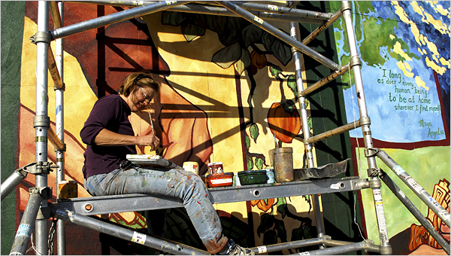
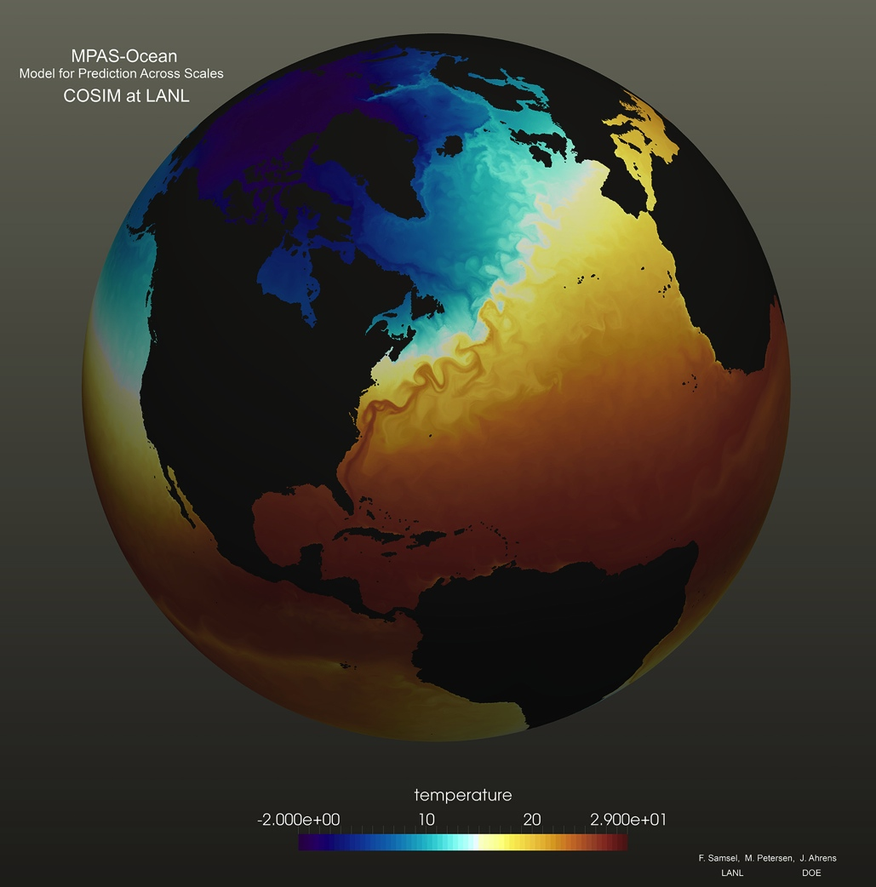
photo: NY Times
Francesca
Samsel
Center for Agile Technology
University of Texas at Austin
Notes:
I my name is Francesca Samsel. I am trained as an artist and spent many happy years painting on the sides of building. Currently I work with domain scientists and visualization teams building means for extracting more value from visualized data..

Slide 2
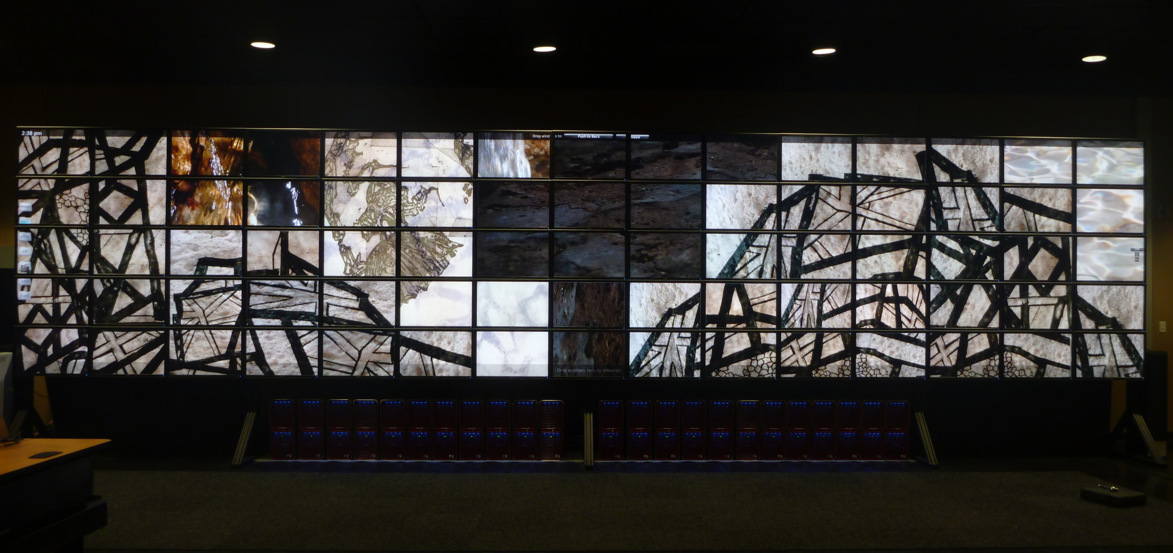
Black Rock / White Japan
incorporates a visualization depicting the wave height estimates for the 2011 tsunami off the coast of Japan. The accompanying imagery speaks to the cycle of building, destruction and rebuilding, involvement with radiation contamination and the dangers that are inherent in living on the ring of fire.
Black Rock, White Japan
Black Rock, Francesca Samsel, 2011
Francesca Samsel
9’ x 34’, 75-monitor tiled-display, 2011
ACES Visualization Lab
Texas Advanced Computing Center
University of Texas at Austin
Visualization - NOAA

Slide 3
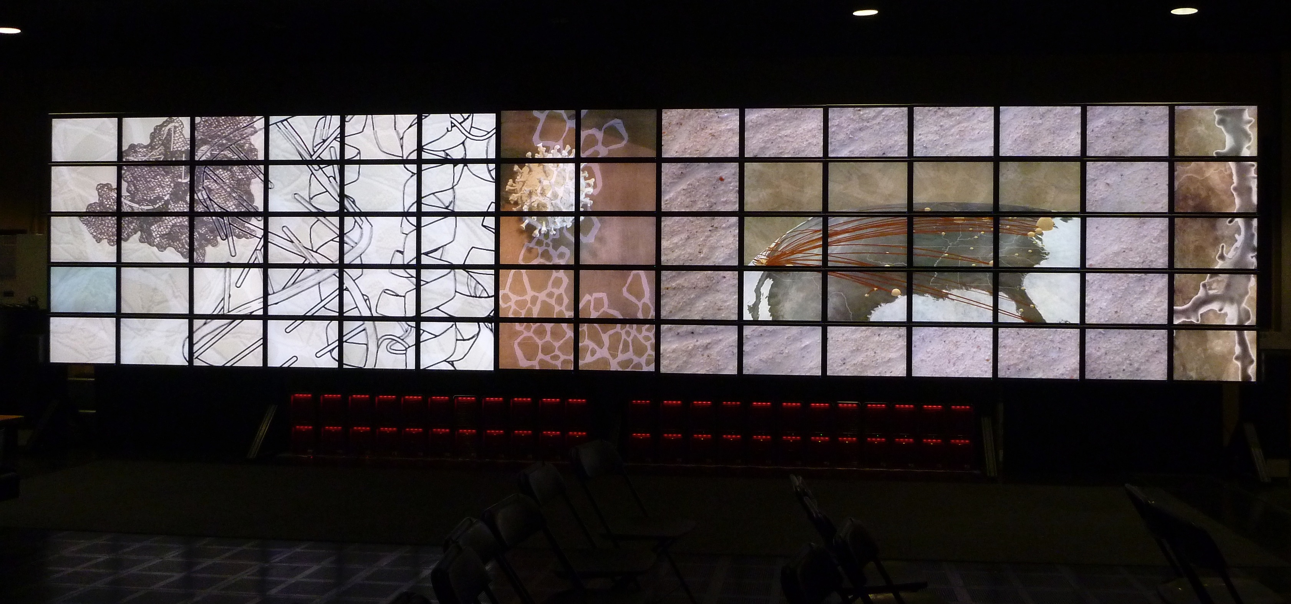
"Transmission"
providing context

Slide 4
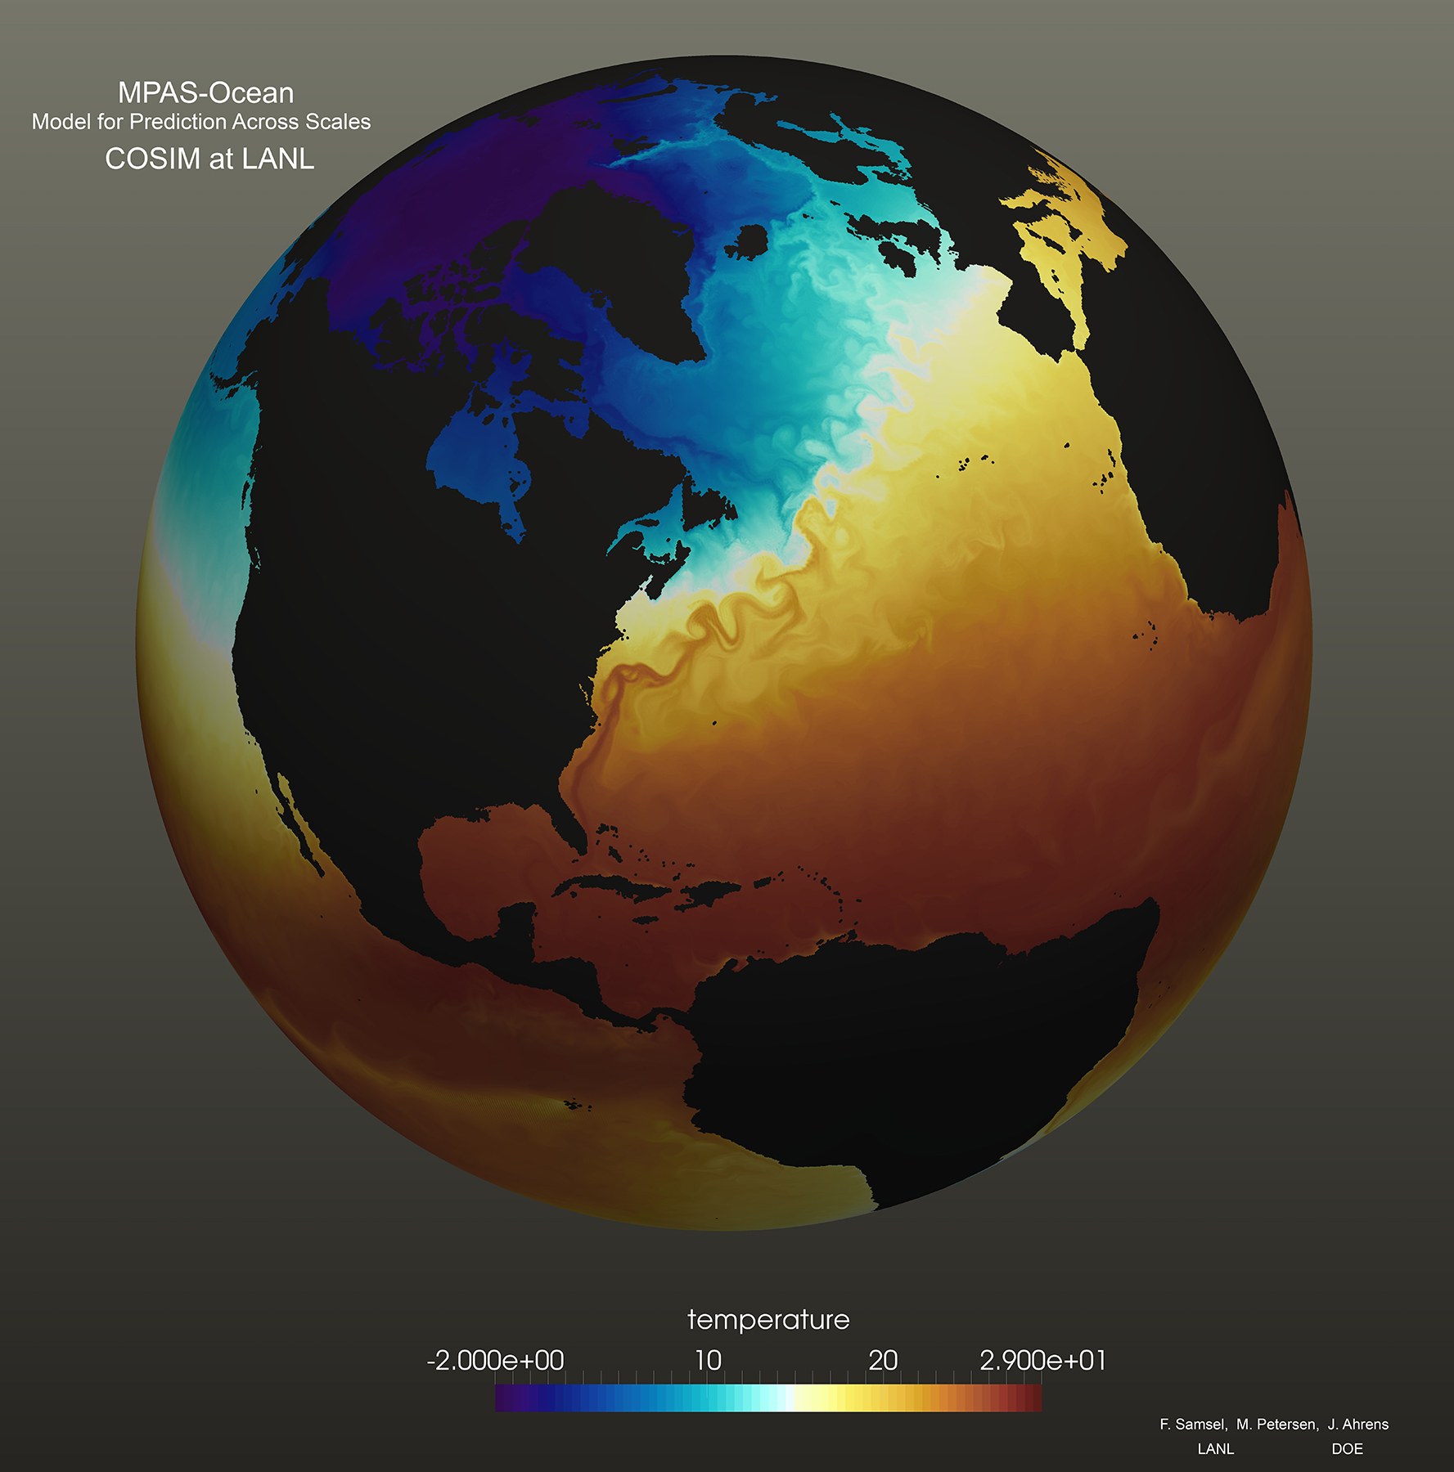
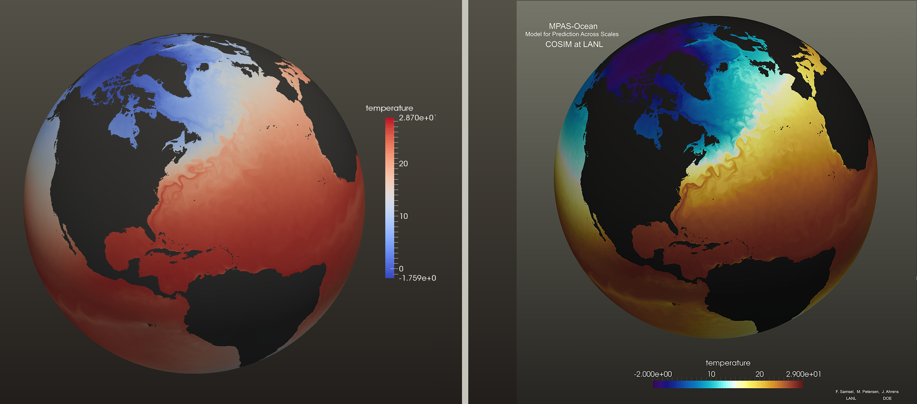
Domain convention
Understanding
via color

Slide 5
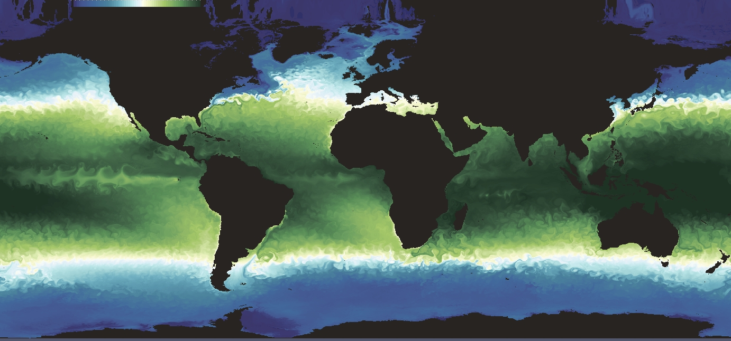

Slide 7
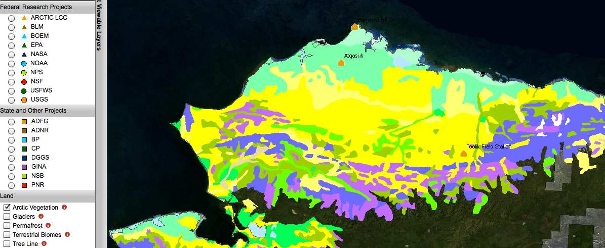
THE WHY ….
Barrow, AK
Plant distribution
……..A friends work

Slide 8
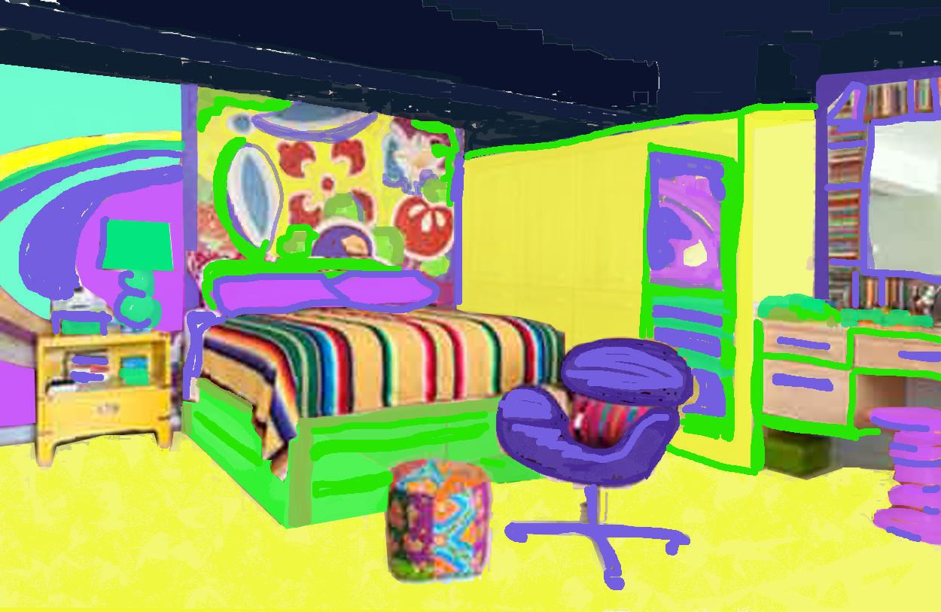
Harmony encourages people to stick around

Slide 9
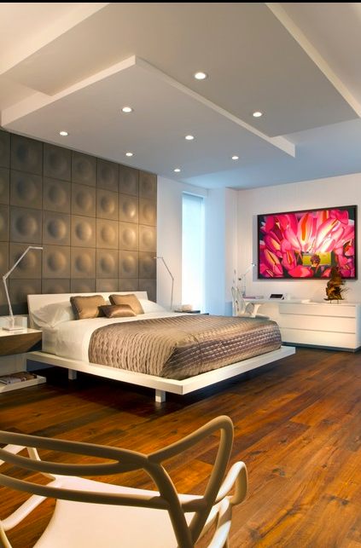
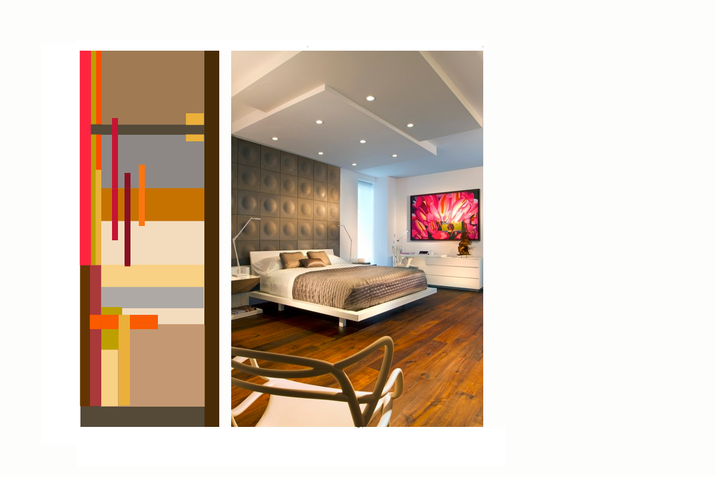
Multi-faceted
harmony

Slide 11
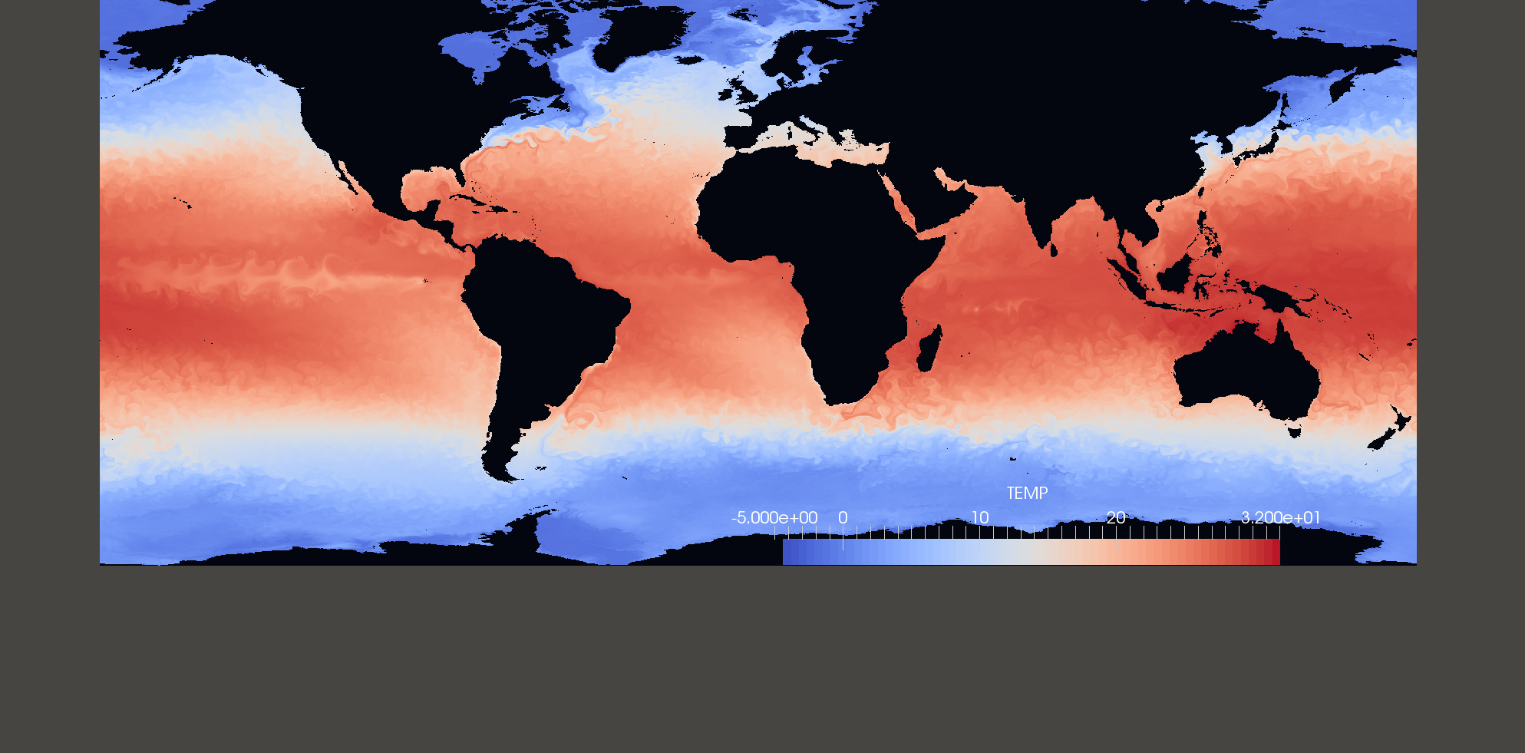
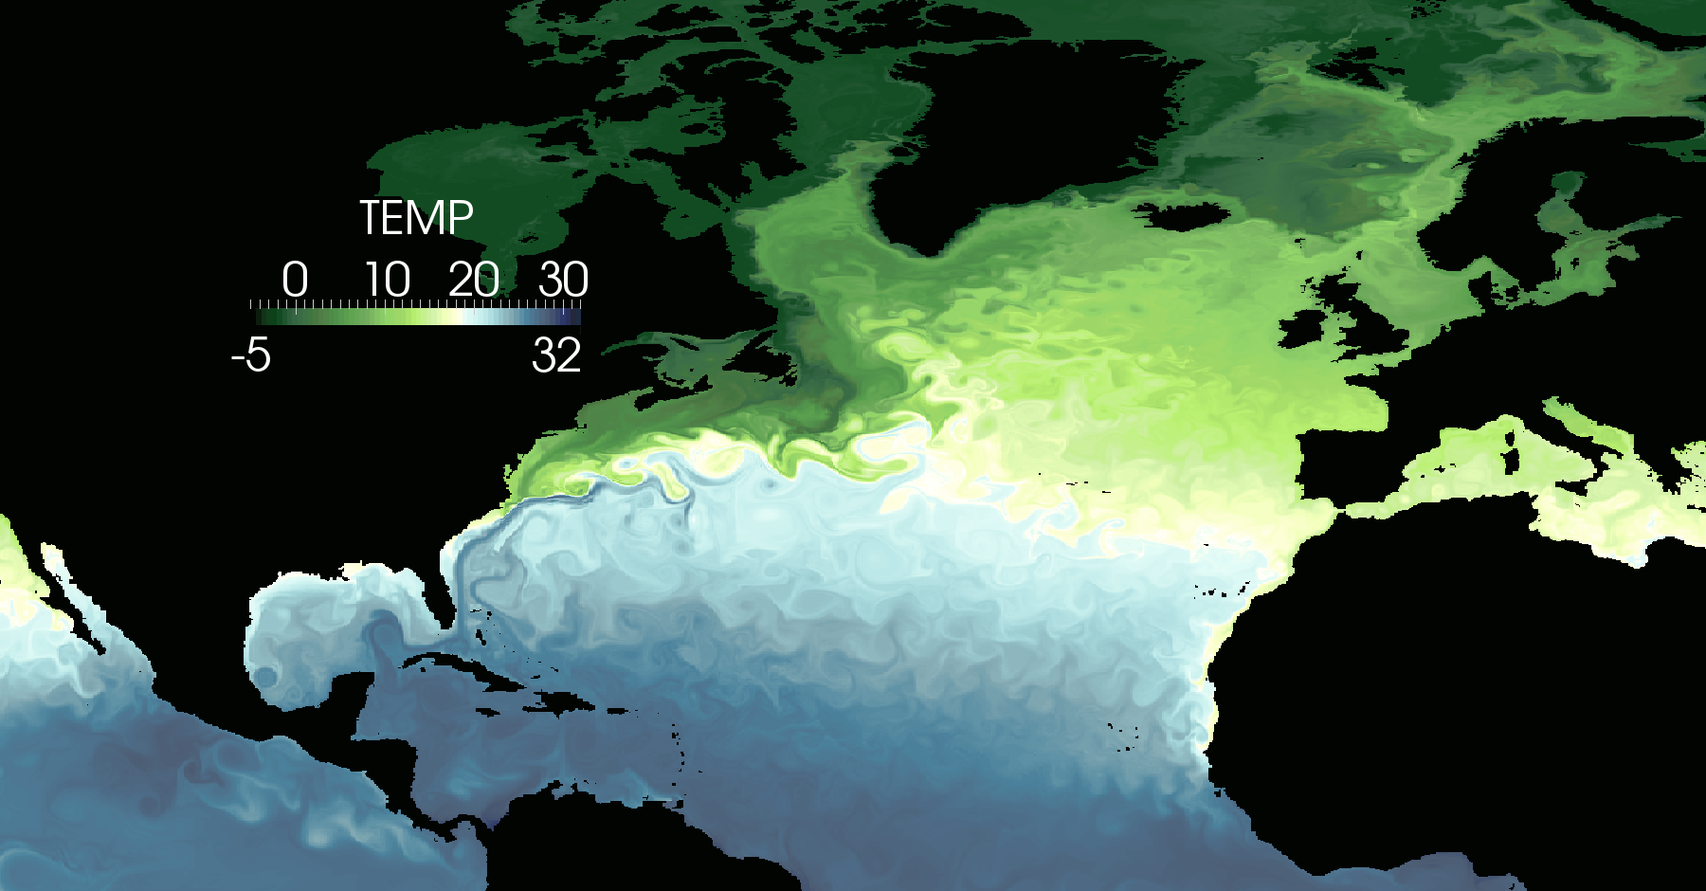
The Climate, Ocean, Sea-Ice Modeling Team, COSIM, LANL
Are interested in understanding the characteristics of ocean currents.
Notes:
Scientists from the Climate, Ocean and Sea Ice Modeling Team (COSIM) at the Los Alamos National Laboratory (LANL) are interested in gaining a deeper understanding of three primary ocean currents: the Gulf Stream, the Kuroshio Current, and the Agulhas Current & Retroflection. To address these needs, visual artist Francesca Samsel teamed up with experts from the areas of computer science, climate science, statistics, and perceptual science. By engaging an artist specializing in color, we created colormaps that provide the ability to see greater detail in these high-resolution datasets. The new colormaps applied to the POP dataset enabled scientists to see areas of interest unclear using standard colormaps. Improvements in the perceptual range of color allowed scientists to highlight structures within specific ocean currents. Work with the COSIM team members drove development of nested colormaps which provide further detail to the scientists.

Slide 12
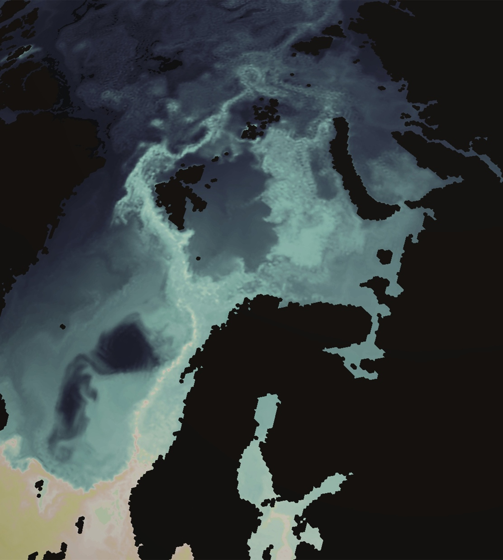
Color is like
a symphony.
There are many voices (instruments).
In harmony, they are magical.
Off key, and we look for the exit door.
Notes:
Color played well is like a symphony.
Think of color ranges, blues, reds and greens as sections of the orchestra and individual colors as notes.

Slide 13

Color Theory 101
Hue
Notes:
Hue is simply what color is it? Blue green yellow..etc.

Slide 14

Value
light
dark
Notes:
Value is how dark or light is it, luminance.

Slide 15


Saturation
fully
saturated
Saturation
mid-range
Saturation
Low Saturation
Notes:
Saturation is the purity, intensity, of the color.

Slide 16

Complementary Color
Complimentary Color
Notes:
Complimentary colors are colors on the opposite sides of teh color wheel

Slide 17
complimentary colors
red / green
- saturated green
- muted green
- blue green
Visualization and Analysis of Large-Scale Atomistic Simulations of Plasma–Surface Interactions
Wathsala Widanagamaachchi, Karl Hammond, Li-Ta Lo,3 Brian Wirth,4 Francesca Samsel, Christopher Sewell, James Ahrens, and Valerio Pascucci
Notes:
This is an example of a complimentary color palette used in a visualization.
note the fully saturated green and the muted green or desaturated green

Slide 18

Analogous Color
Notes:
Analogous color is color that is close together on the color wheel.

Slide 19
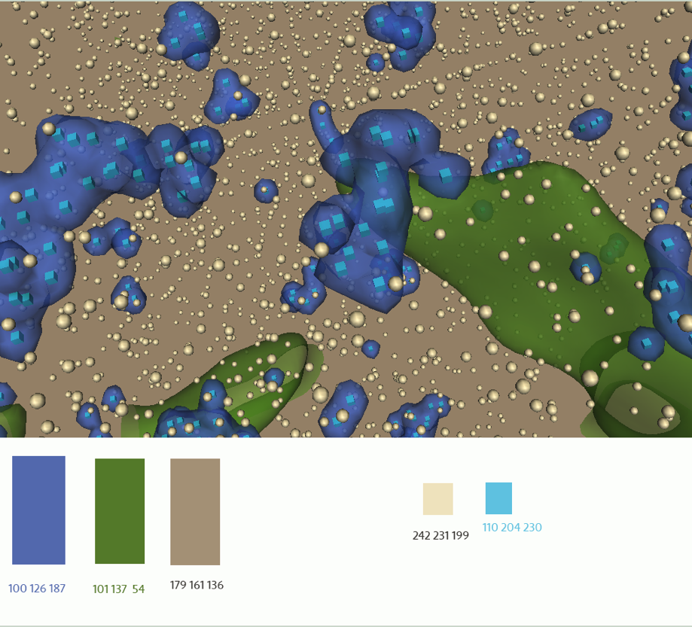
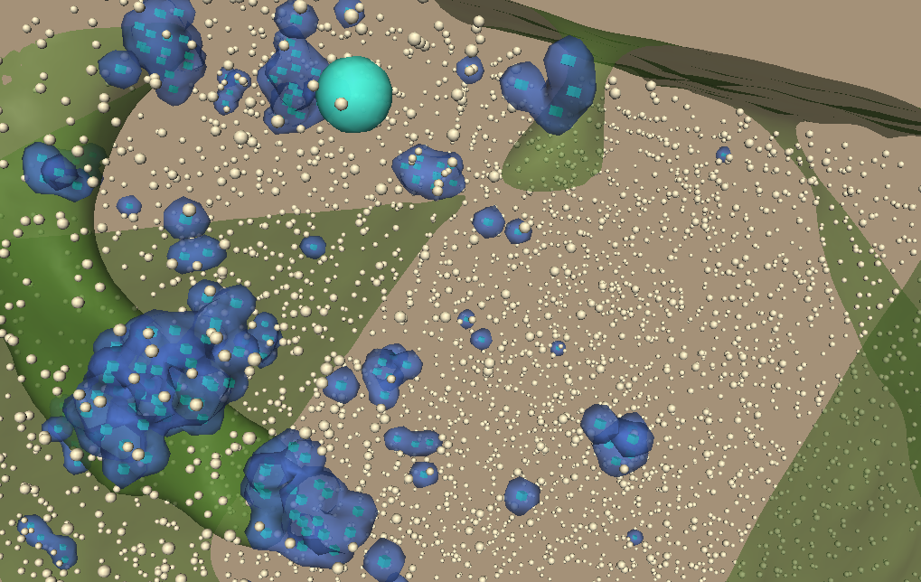
Using color to
organize, categorize
and direct attention
Analogous color
cool colors on a
warm neutral background
Notes:
Here is the same visualization using an analogous color range.
The analogous range unifies the whole but there is still plenty of room for differentiation.

Slide 20
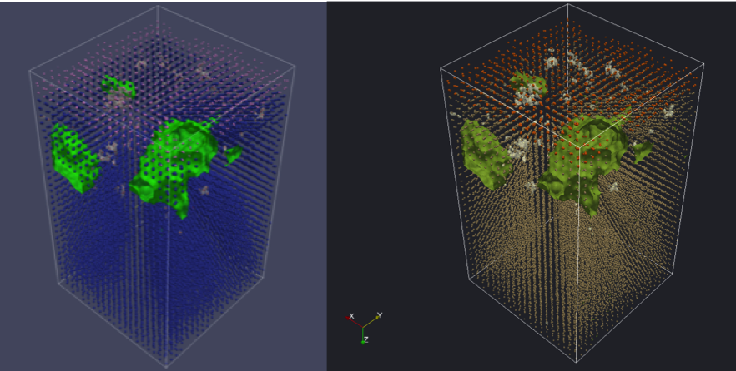
Visualization and Analysis of Large-Scale Atomistic Simulations of Plasma–Surface Interactions
Wathsala Widanagamaachchi,1 Karl Hammond,2 Li-Ta Lo,3 Brian Wirth,4 Francesca Samsel,5 Christopher Sewell,3 James Ahrens,3 and Valerio Pascucci1
Notes:
This is the original before and after of that same data set.
Te scientists were most interested in the white shapes, which are a pink on the left and too close in value to the background rending them difficult to see. The second most important information is rendered in green. The pink, left/ orange right dots are also important. However the blue dots are there only for context.
When I say color is like a symphony, what I mean is that just as with a musical score, one needs to control the balance, the emphasis and relationships between color, just as a composer does with musical notes.

Slide 21
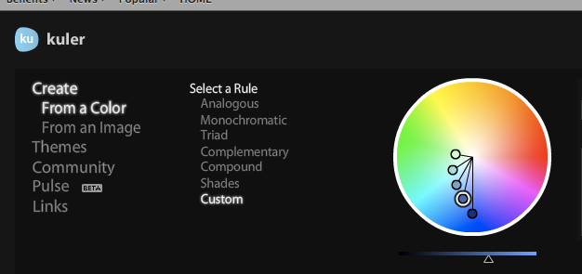
THE HOW …
Basic Types of Contrast
Value
Hue
Saturation
Opacity
Warm / cool
Texture
Lighting
Luminosity
Combinations of the above - the most useful…
and also endless

Slide 22
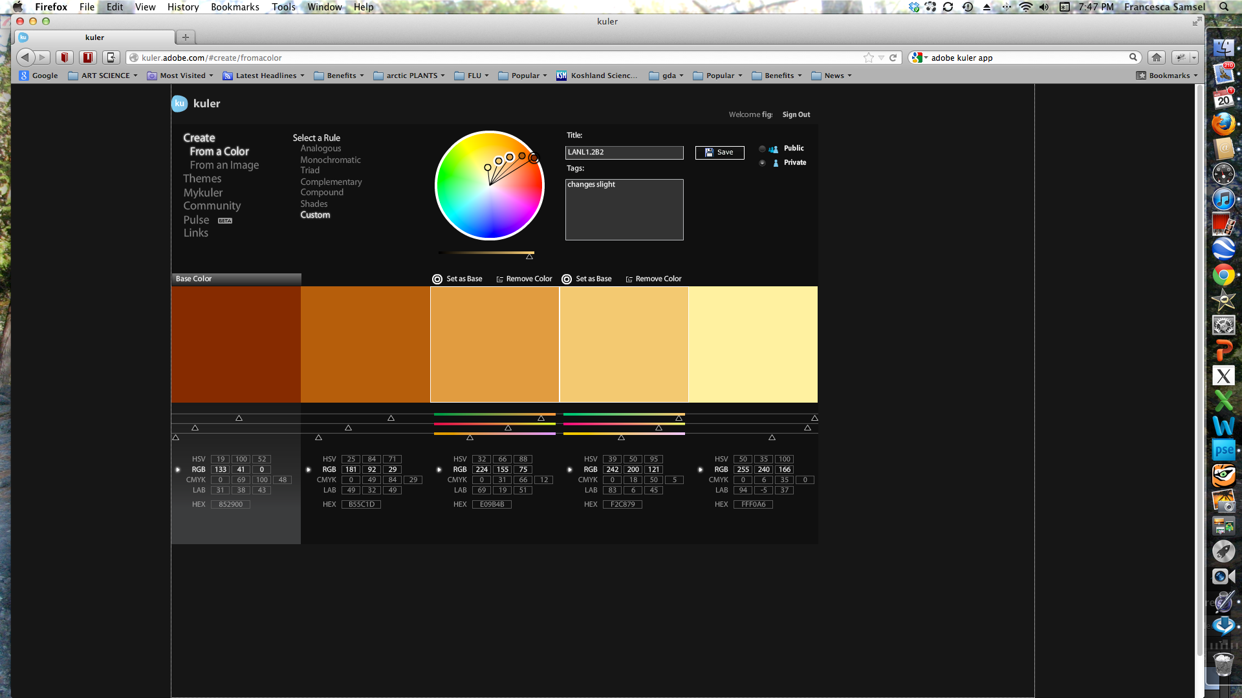
An arc will produce a scale spanning hue and value.

Slide 23
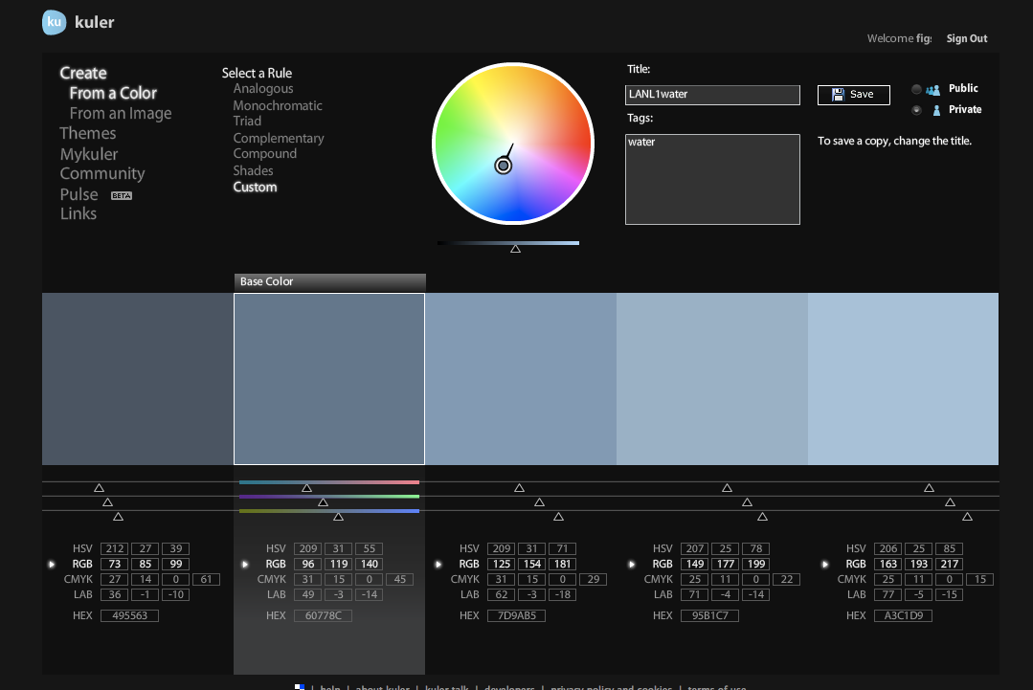
linear
Using only value contrast makes it too hard to distinguish between colors

Slide 24
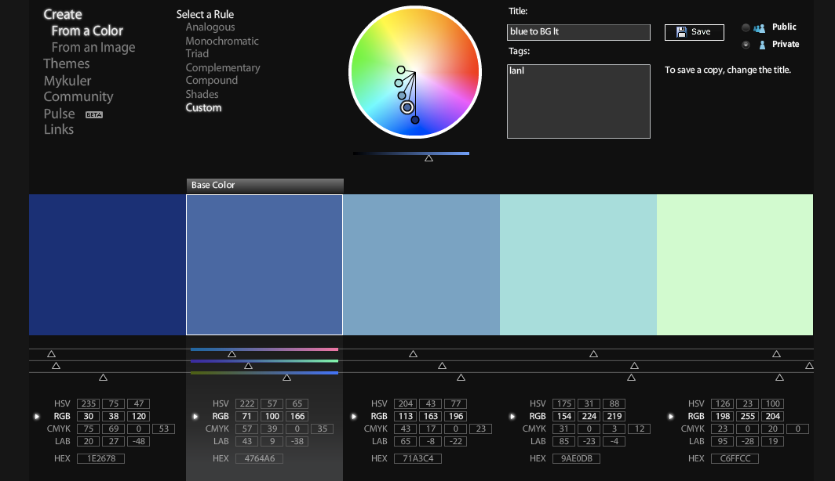
Note the configuration
Color scale spans hue, value and saturation

Slide 25
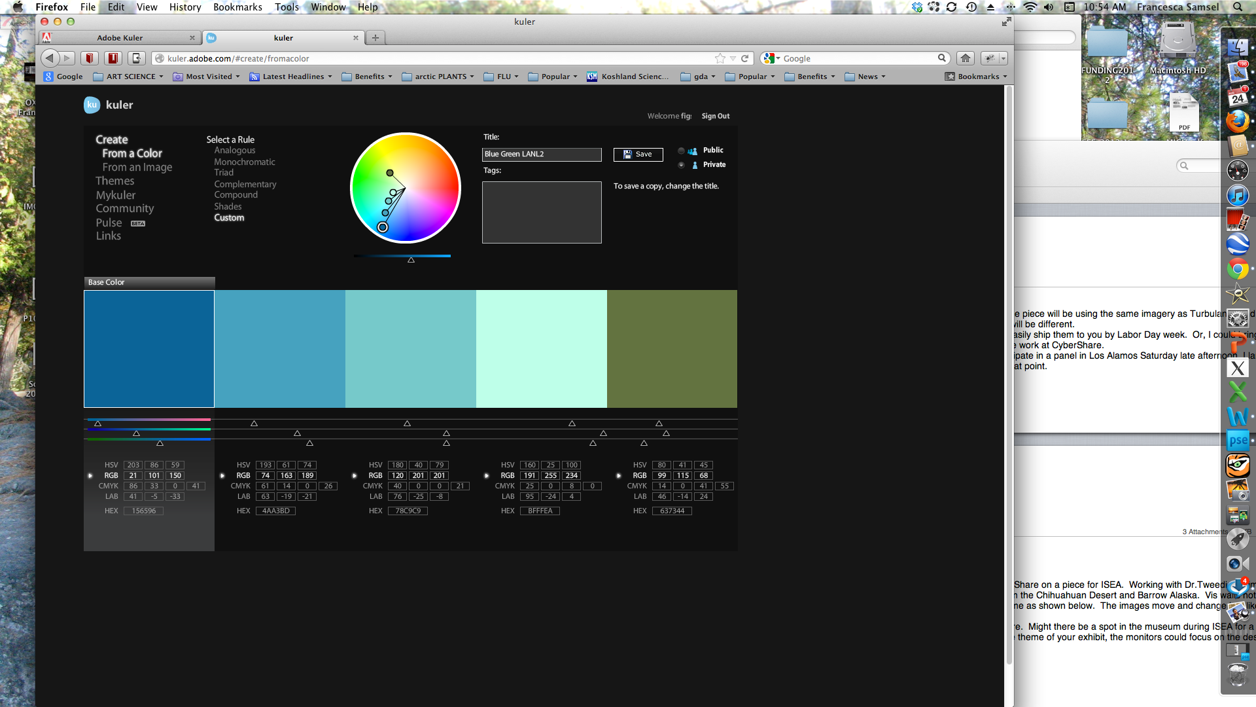
Value with contrasting hue highlight

Slide 26
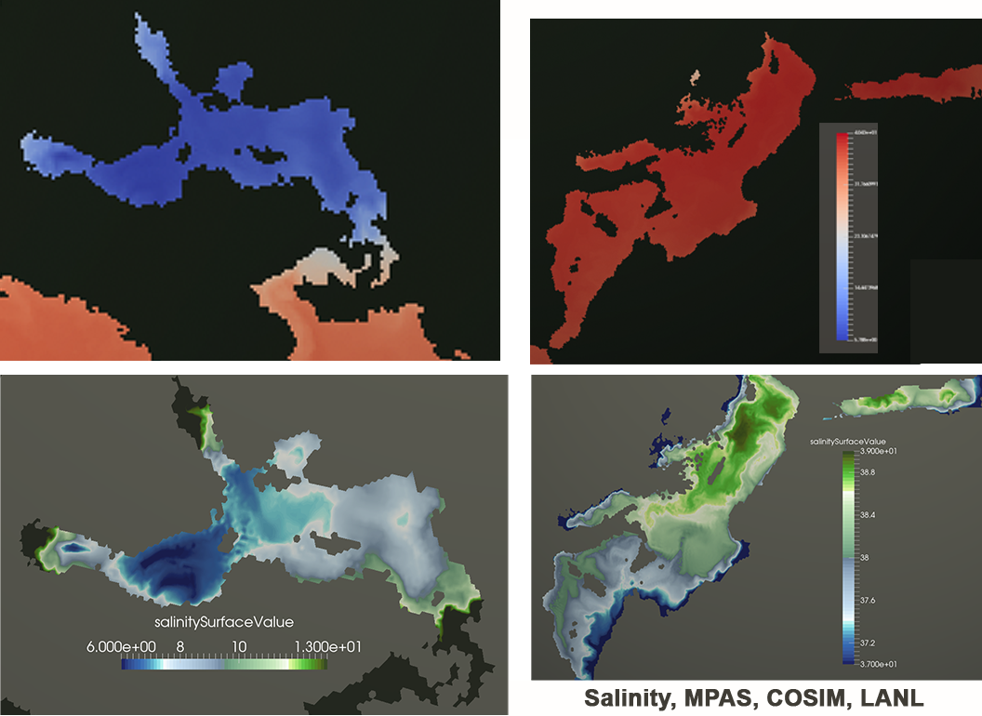
Directing the color contrast to the data ranges of interest.

Slide 27
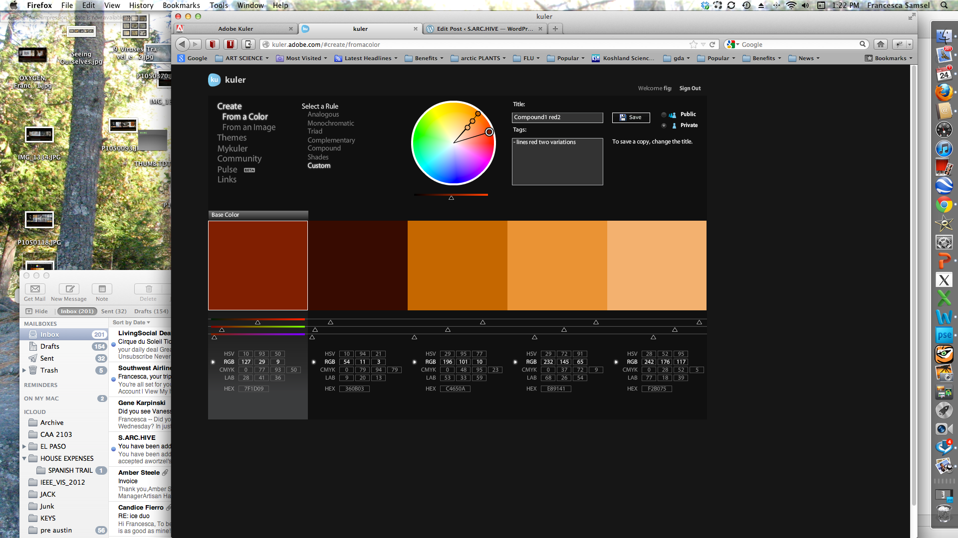
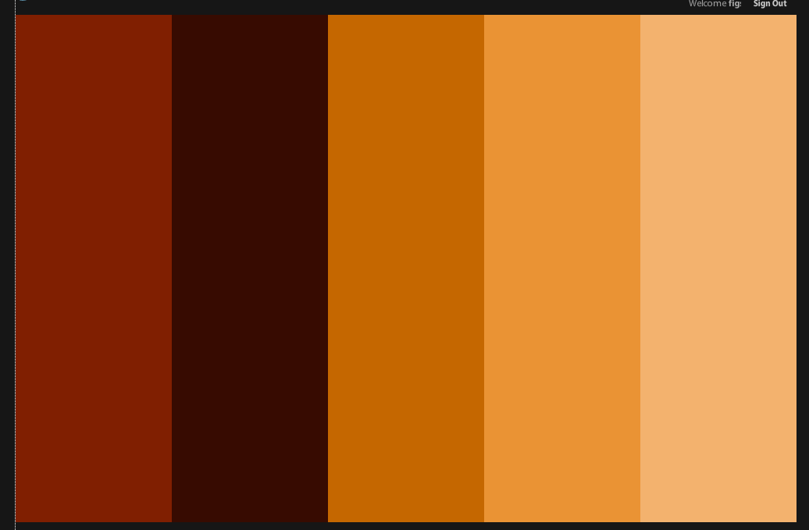
Linear
with analogous accent

Slide 28
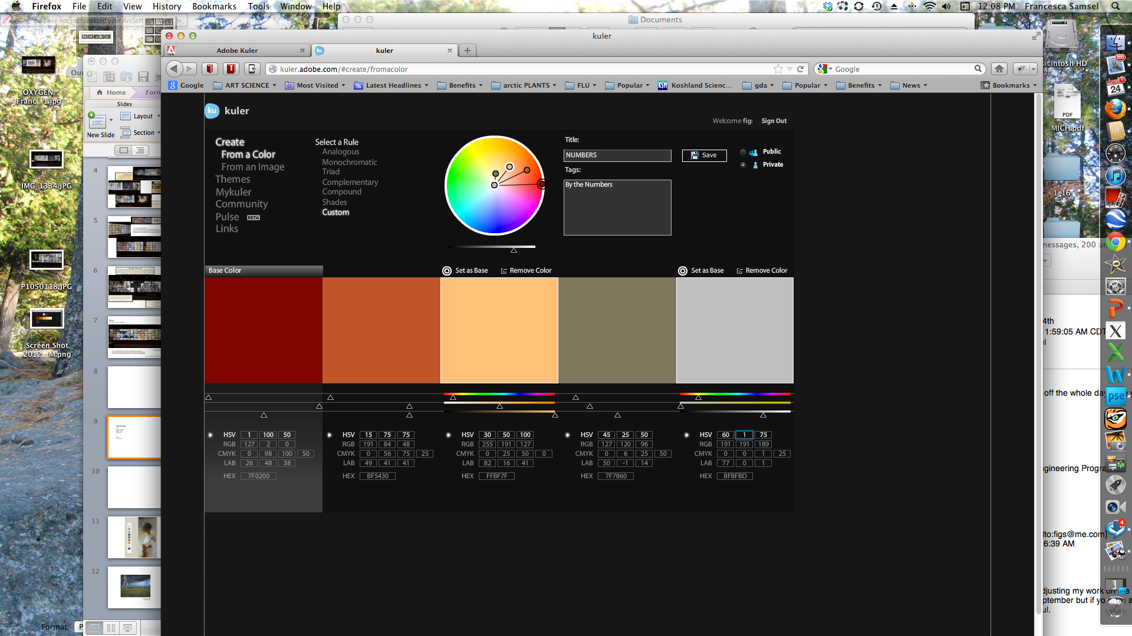
Number symmetry

Slide 29
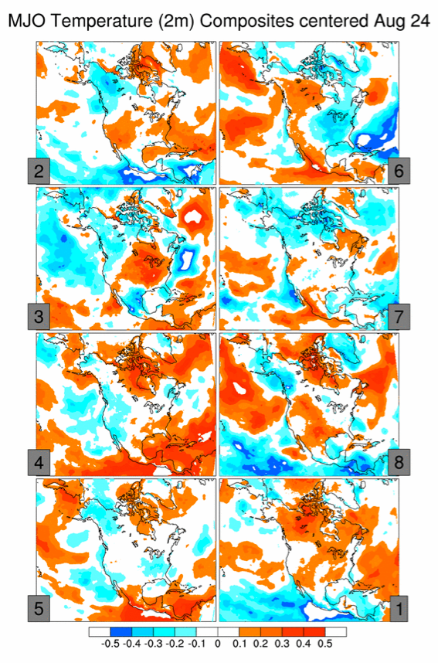
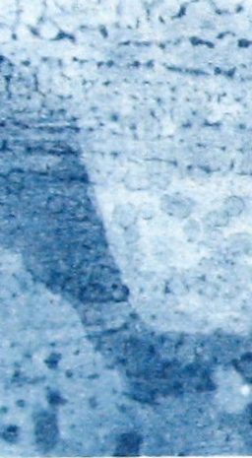
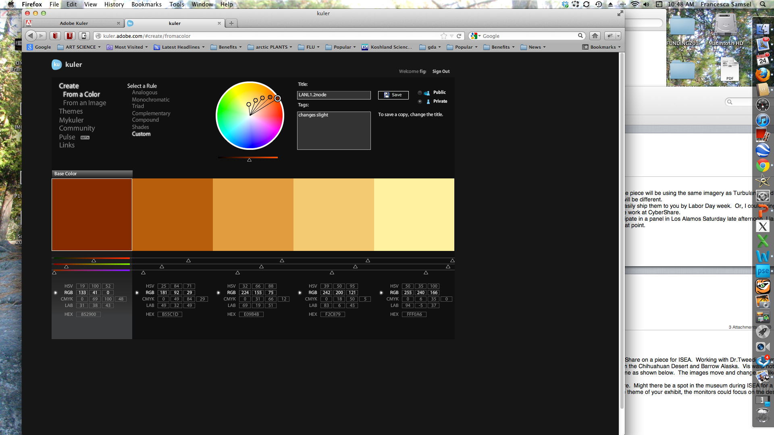
Fully saturated colors vibrate against one another.
Using slightly muted colors gives you the same amount of
contrast without the distracting color interactions.

Slide 30
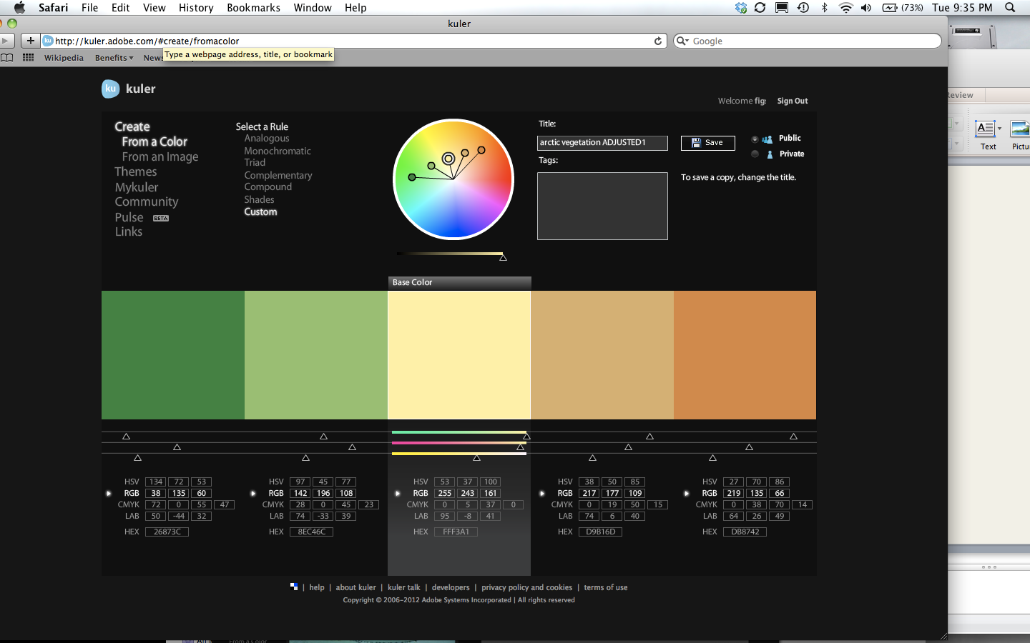
dark light dark
Note the symmetry
warm to cool

Slide 31
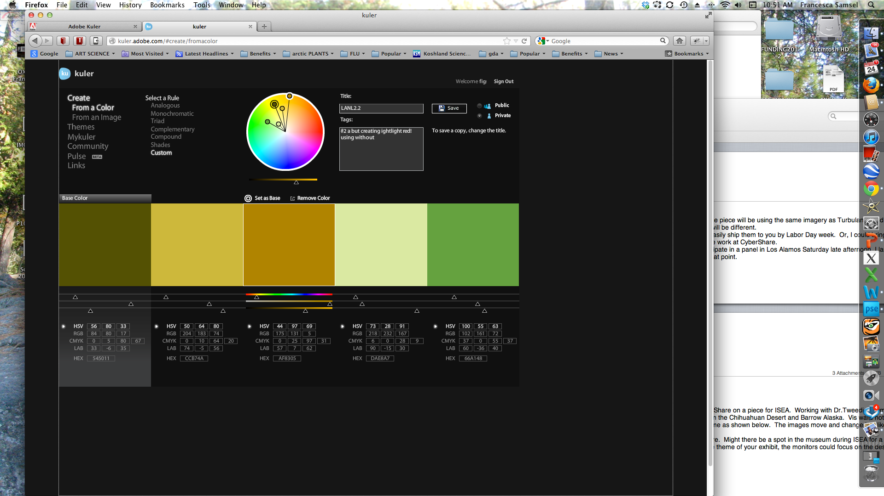
Duel spiral
Muted and crisp
Five values
Analogous color

Slide 32
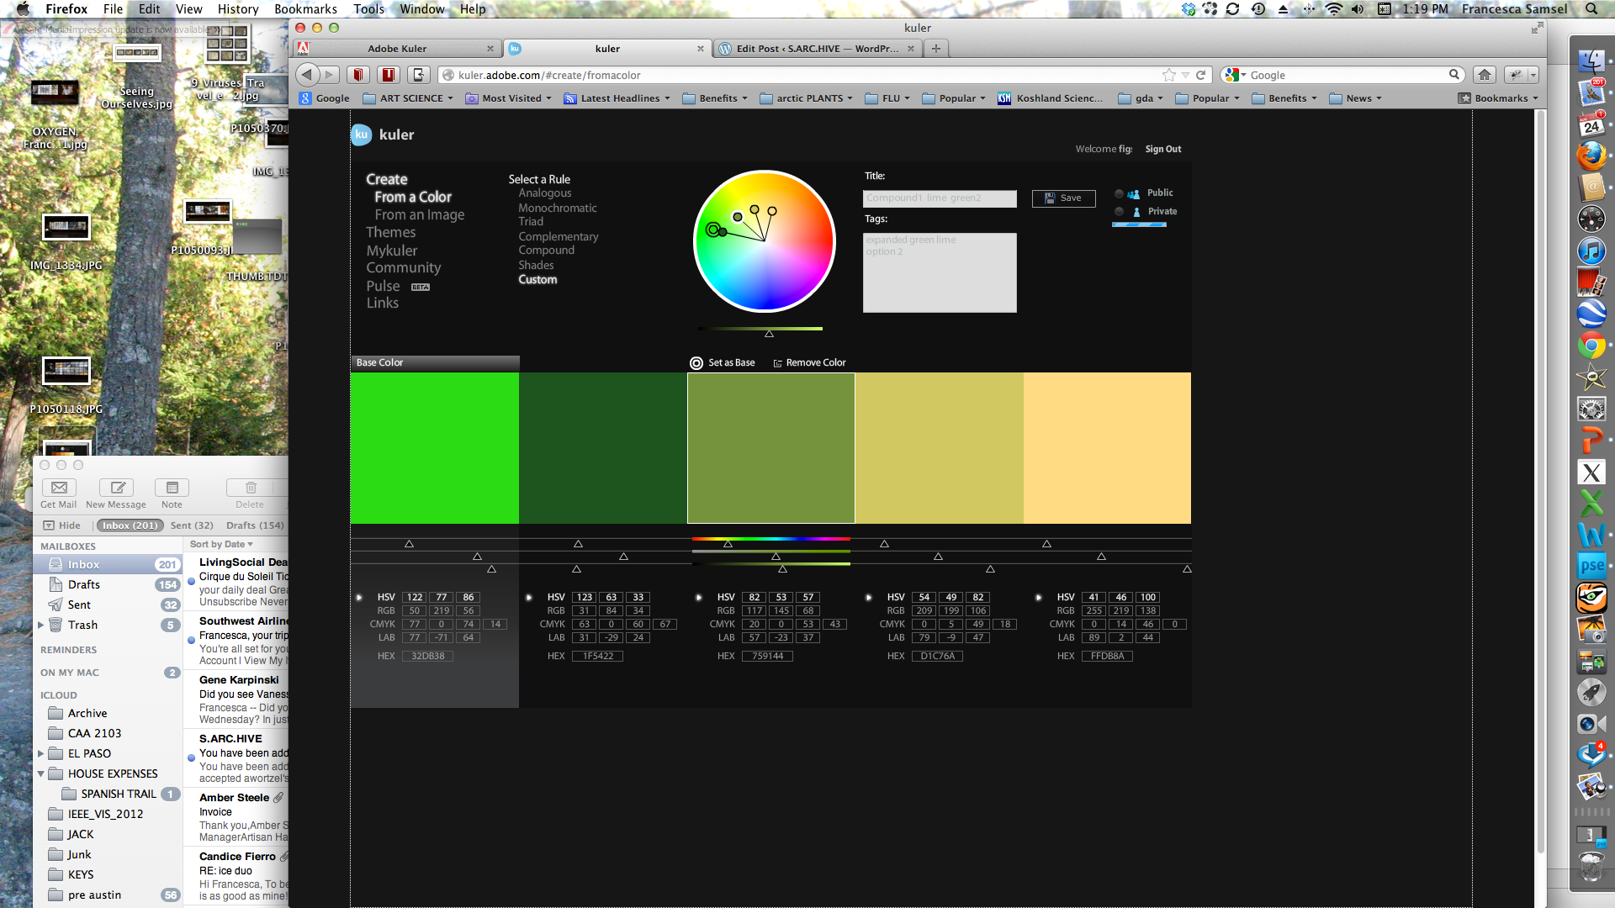
Highlight one variable using a contrast of saturation
saturated
muted
one scale with saturated highlight

Slide 33
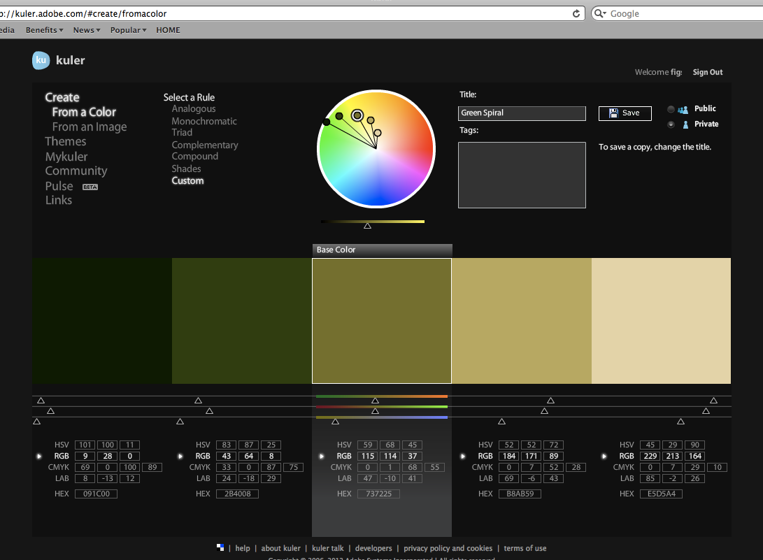

Slide 34
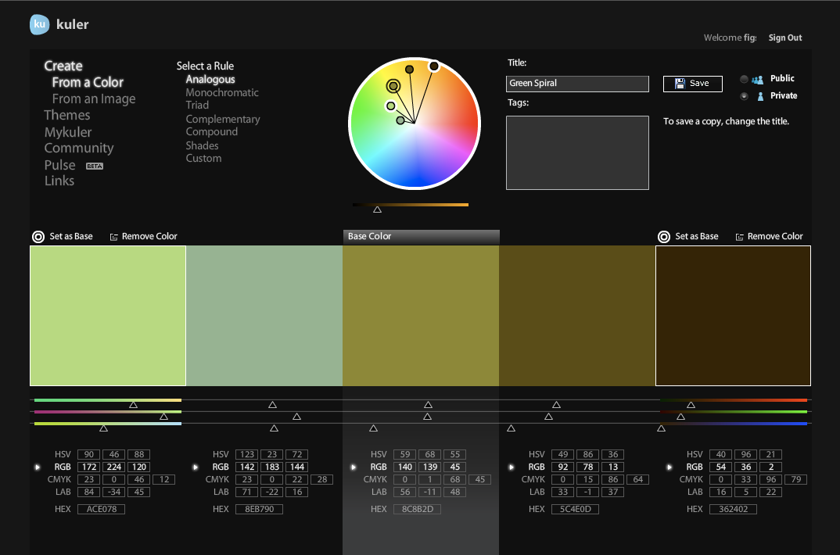
A muted range of
Values using analogous color,

Slide 35
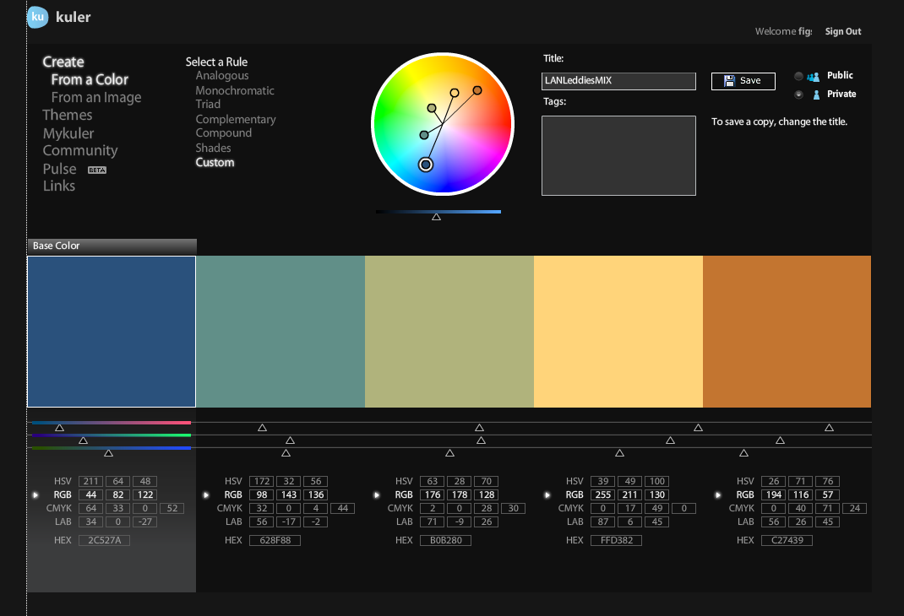
Symmetry !
Choose color that rerlates to your subject

Slide 36
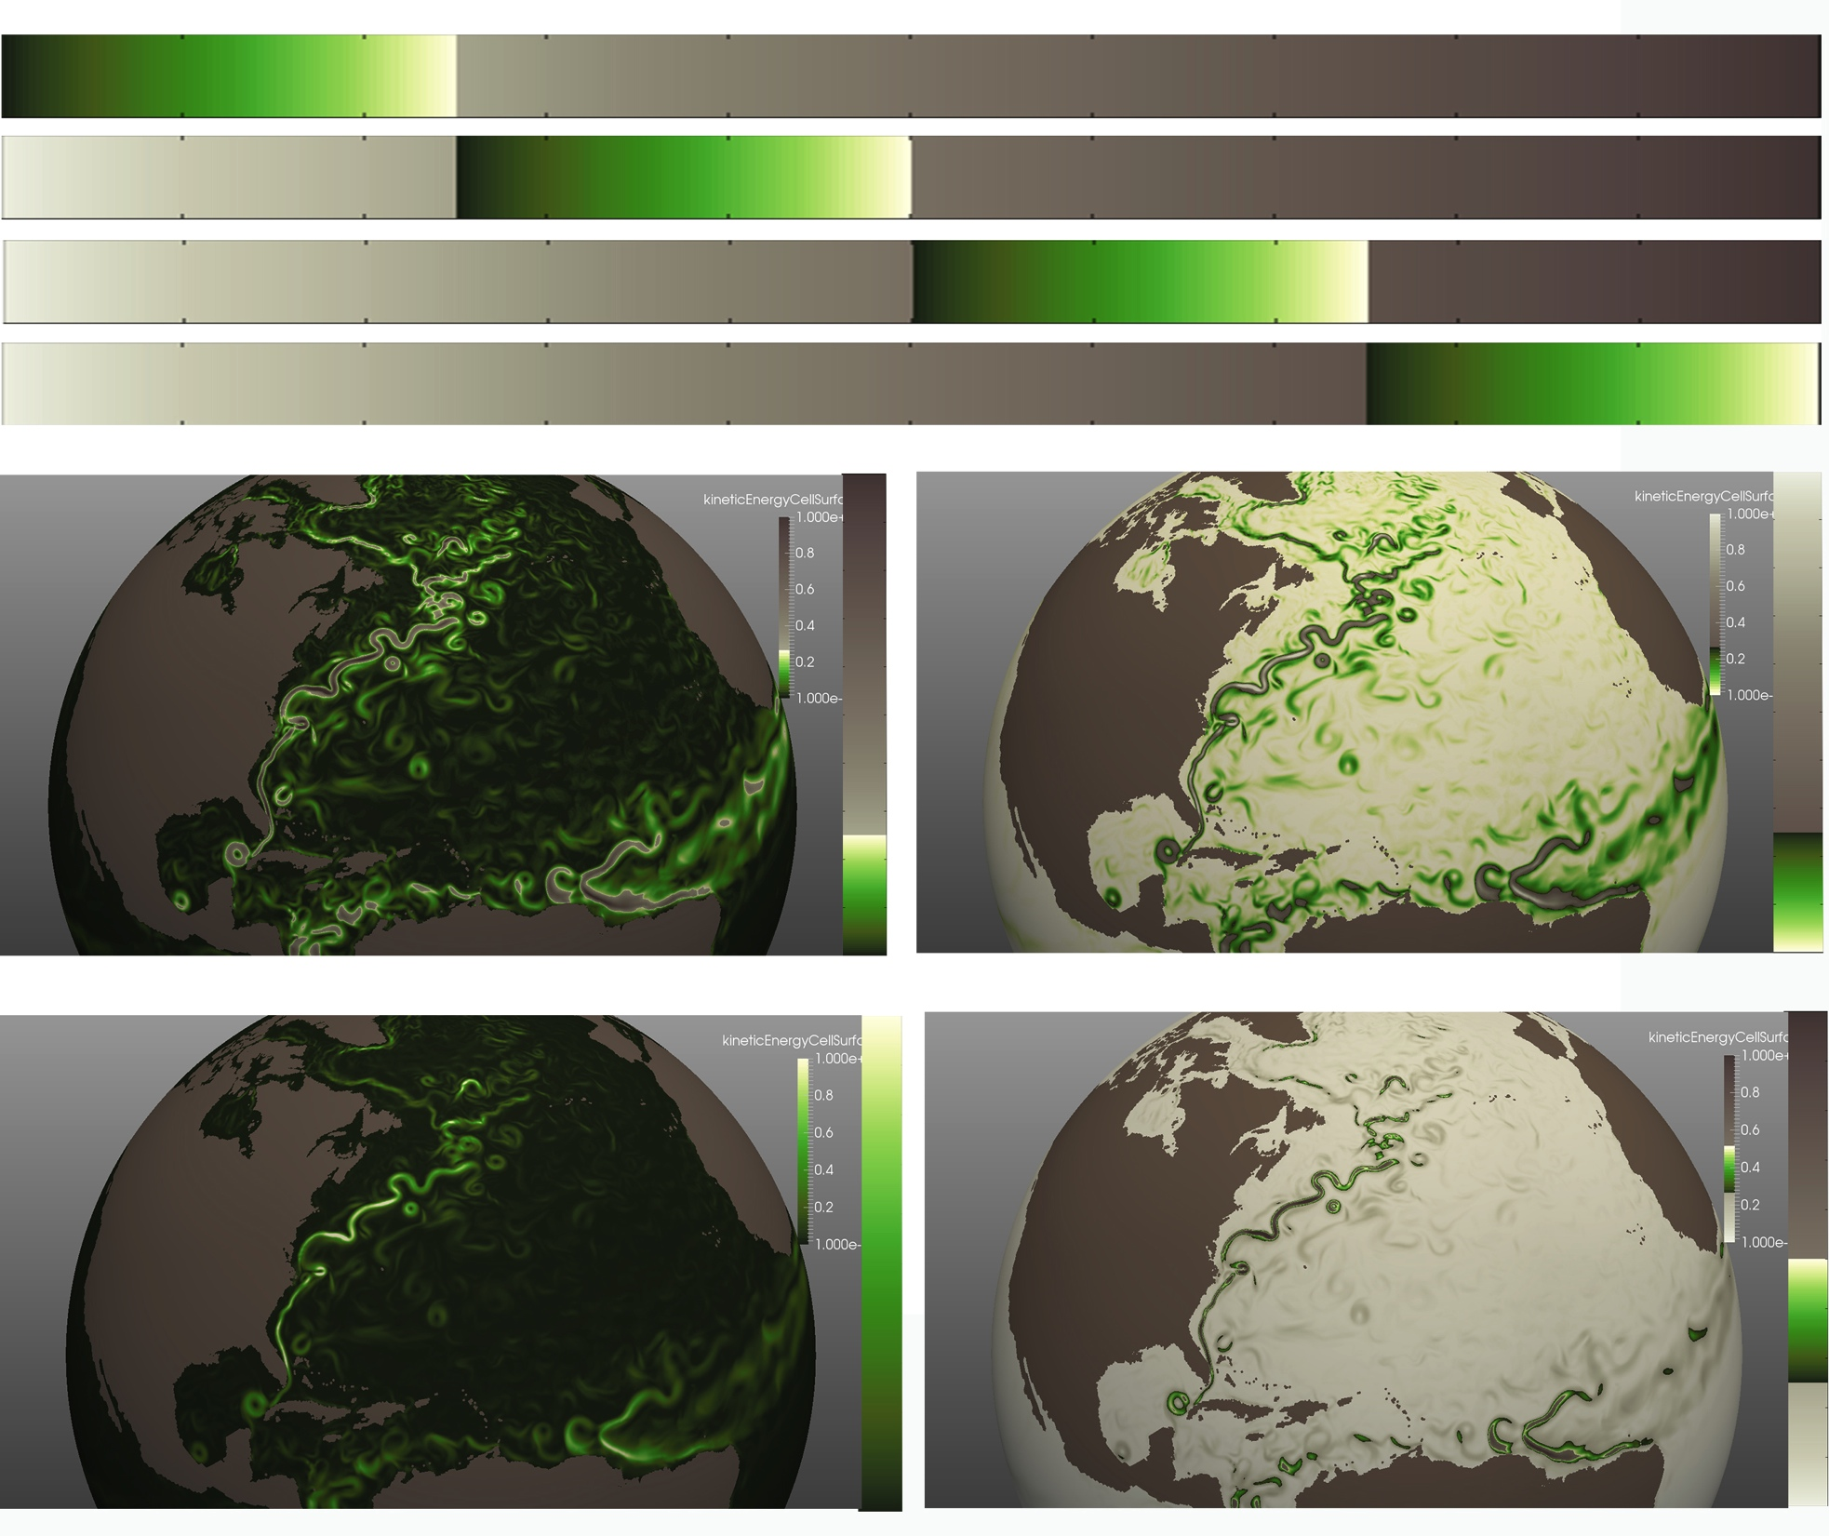

Slide 37
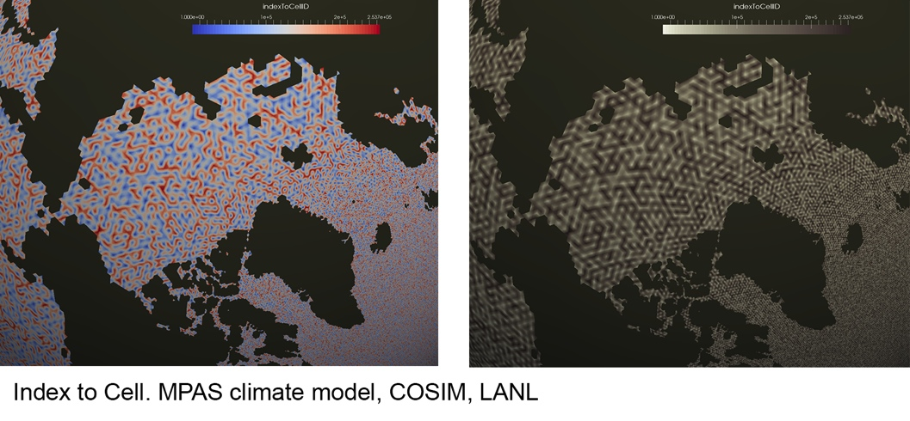

Slide 38
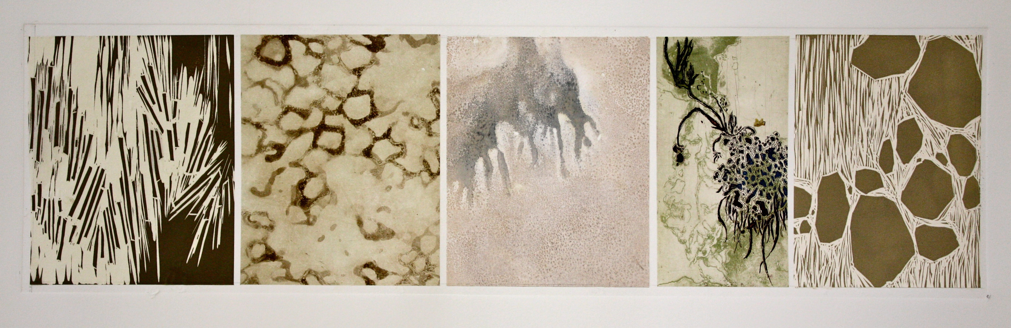
U s I n g
N e u t r a l s
intaglio and viscosity etching, woodcut and chine colle
9” x 24” 2010

Slide 39
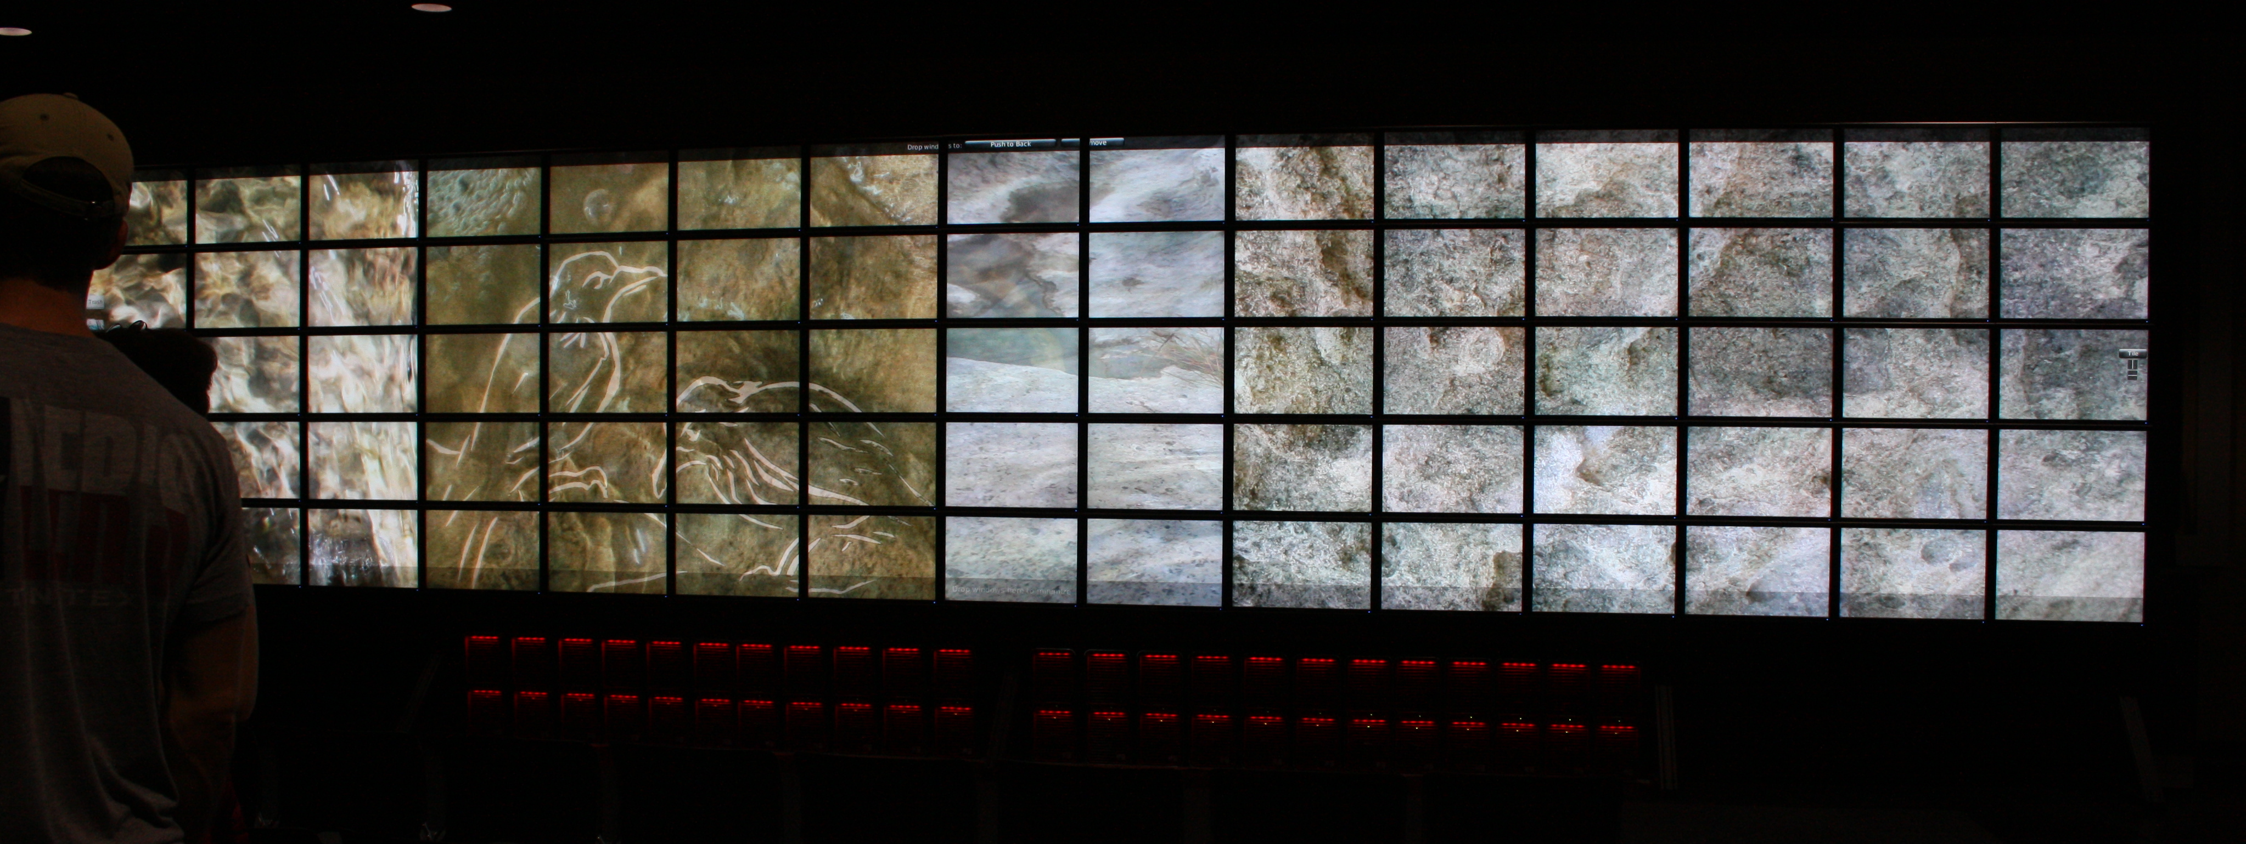
BREATHING S P A C E
The Need of Neutrals

Slide 40
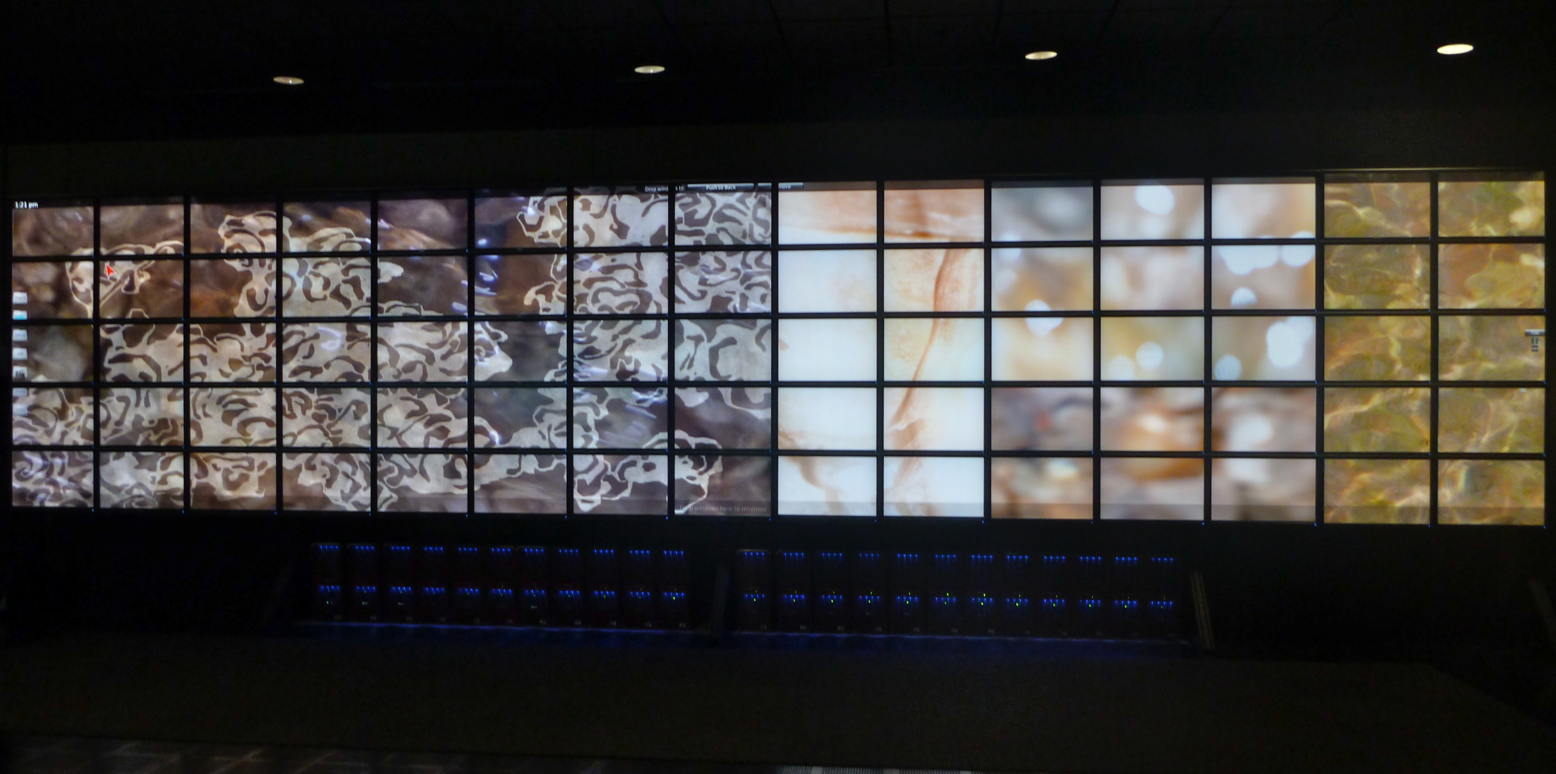
still from Residue
ACES Visualization Lab
Texas Advanced Computing Center
University of Texas at Austin

Slide 41
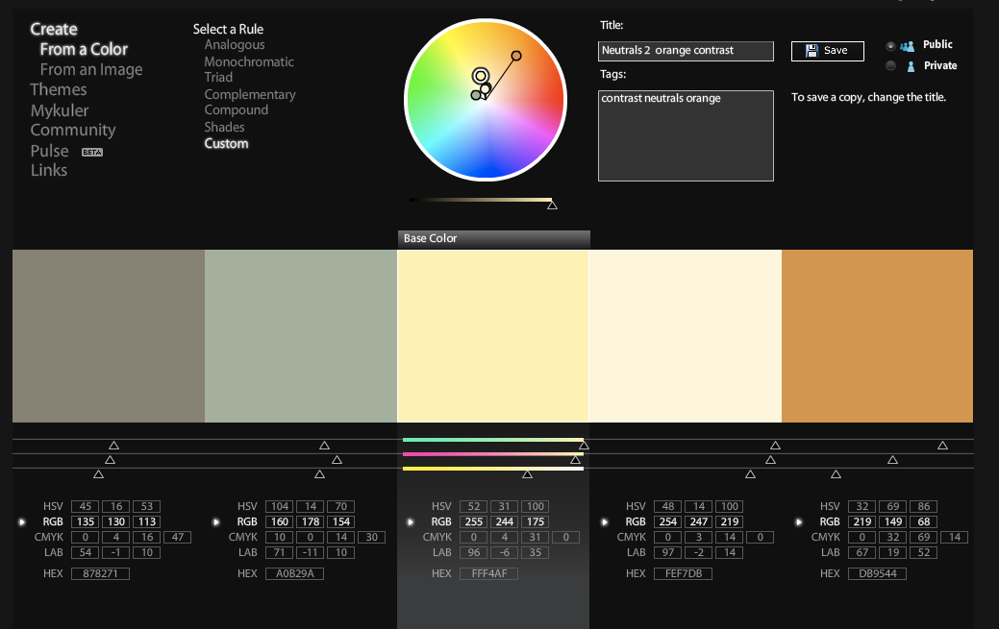
Neutrals – variation in hue

Slide 42
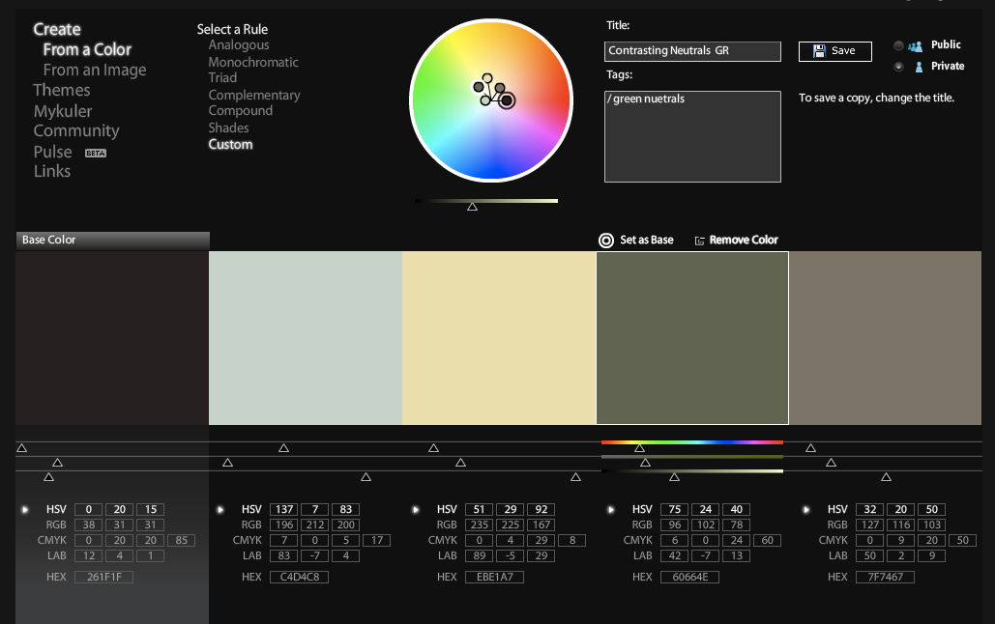
Neutrals in a hue spiral

Slide 43
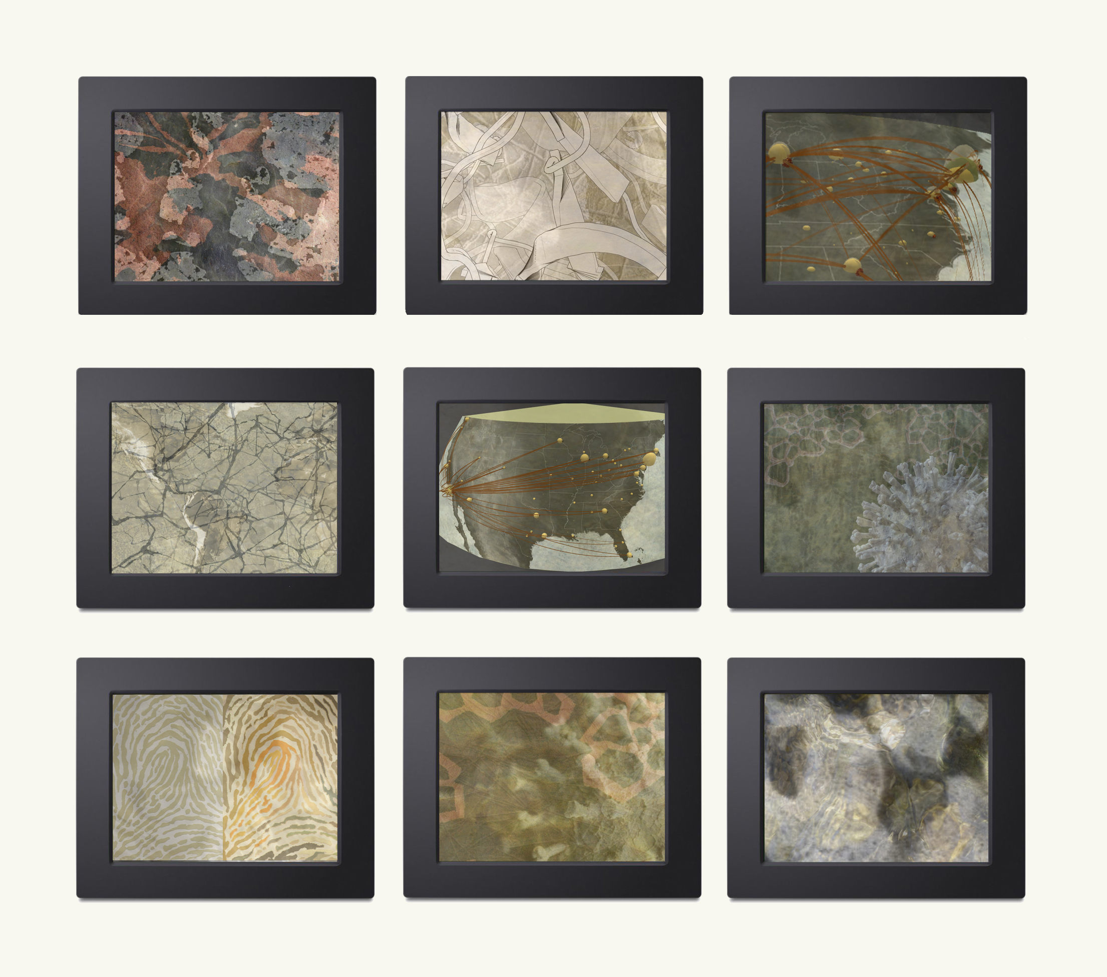
A work referencing the pandemic flu transmission research by Dr. Lauren Meyers, UT Austin.
Transmission
nine 7” digital photo frames
2012
Visualization in collaboration with
Kelly Gaither and Karla Vega,
Texas Advanced Computing Center,
University of Texas at Austin
.

Slide 44
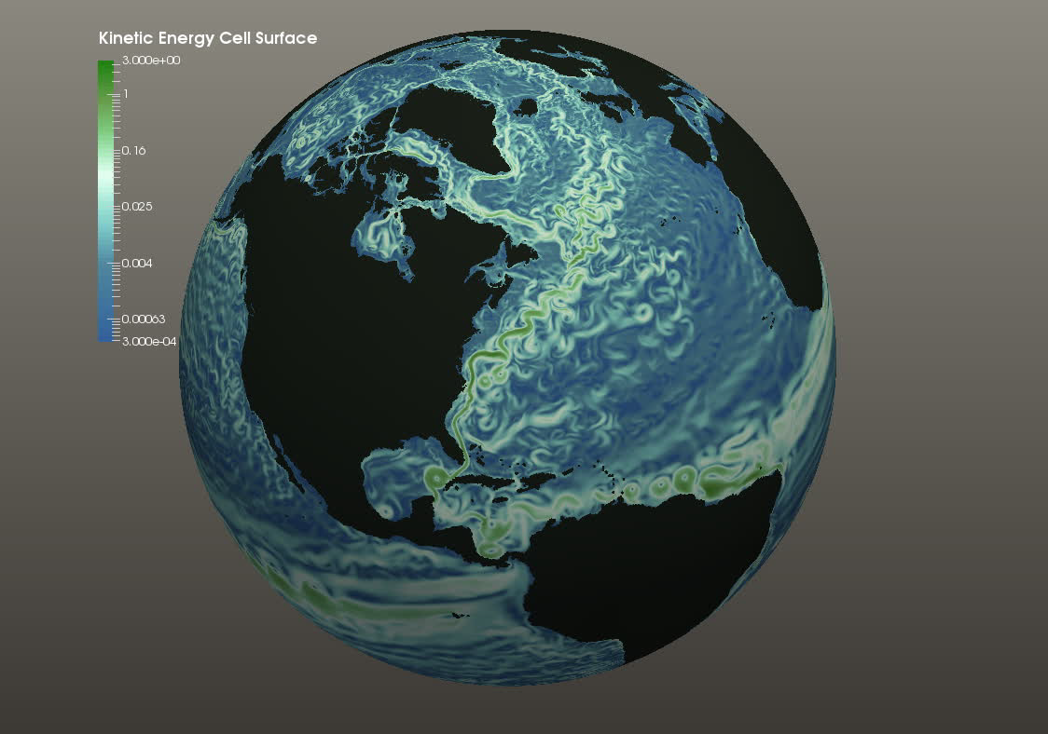
gentle
Gentle
Highlighting
Use only as
much of your
color budget
as necessary.
video

